Slide 1
DS 501
Case Study 1
Team 12
Team Members
Chu Wang
Di You
Rishitha Kiran
Saranya Manoharan
Valerie Tuzel

Slide 2

To improve its system-wide punctuality Ryanair decides to cancel “up to 50” flights a day until the end of October!!

Slide 3
Frequency Analysis
Word | Count
cancelled | 736
list | 337
cancels | 313
next | 302
get | 257
day | 256
pilots | 219
cancellations | 216
know | 215
rights | 185
leave | 183
cancelling | 180
people | 173
Word | Count
dont | 171
messing | 170
days | 167
weeks | 166
entitled | 159
full | 158
losing | 156
us | 150
brexit | 149
forget | 147
workers | 146
annual | 141
customers | 138
Word | Count
talk | 736
lgoing | 337
please | 313
one | 302

Slide 4
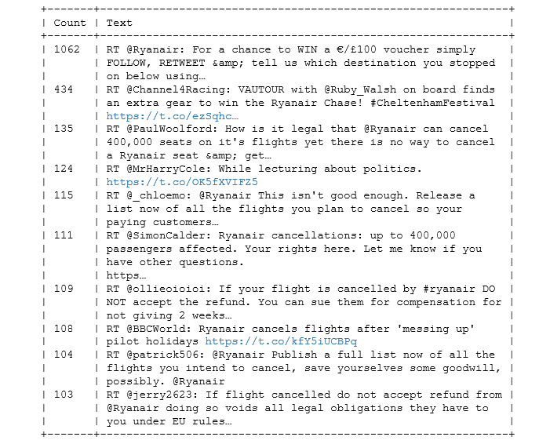
Most Popular Tweets

Slide 5
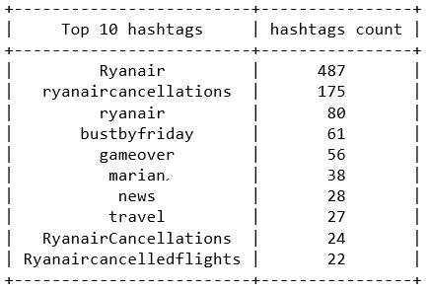
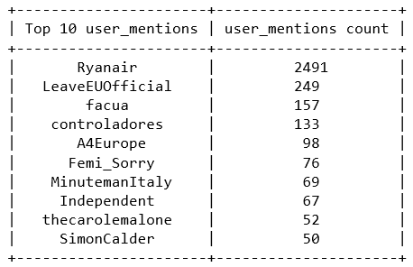
Top 10 Hashtags and User Mentions

Slide 6
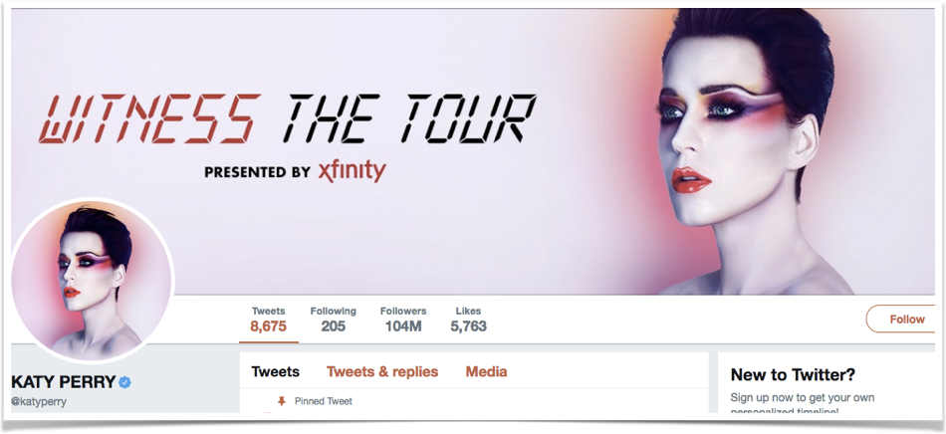
Katy Perry
Katy Perry has 205 friends and 104 million followers.
She is the first user on Twitter to achieve
100M followers.

Slide 7
Problem we encountered:
Twitter tends to block the connection for a while when it believes the crawl rate is too fast, and we need to retry after 15 minutes break. Therefore it is very difficult to collect a large number of IDs
Our solution:
Each time after we got 5000 IDs, we wrote the data into a file before continuing the data extraction process. This design guaranteed that we will not lose all our data when the service disconnected accidentally and could save the memory when the dataset is too large

Slide 8
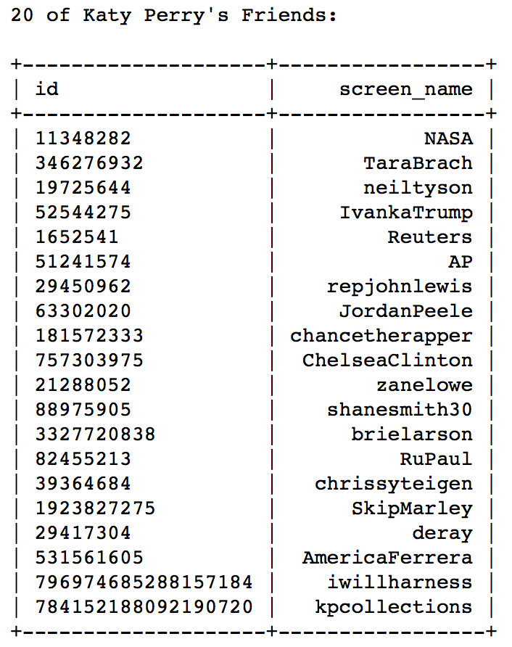
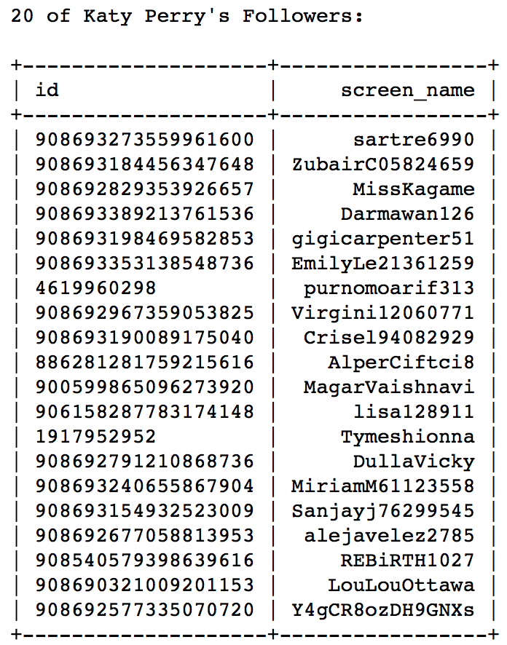
20 Users From the Friends and Followers Lists

Slide 9
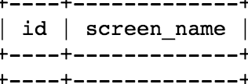
Mutual Friends within Two Groups
Katy Perry is only following 205 people. Even if there are mutual friends, with only 0.19% of her total followers as our followers data we had a slim chance to get those who are in both lists.

Slide 10
Business Question:
Was this a good business strategy?

Slide 11
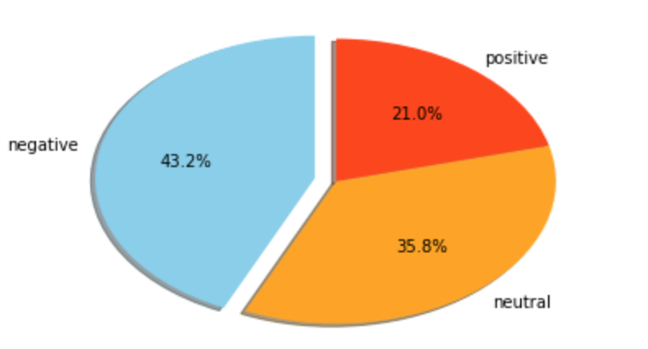
Sentiment Analysis

Slide 12
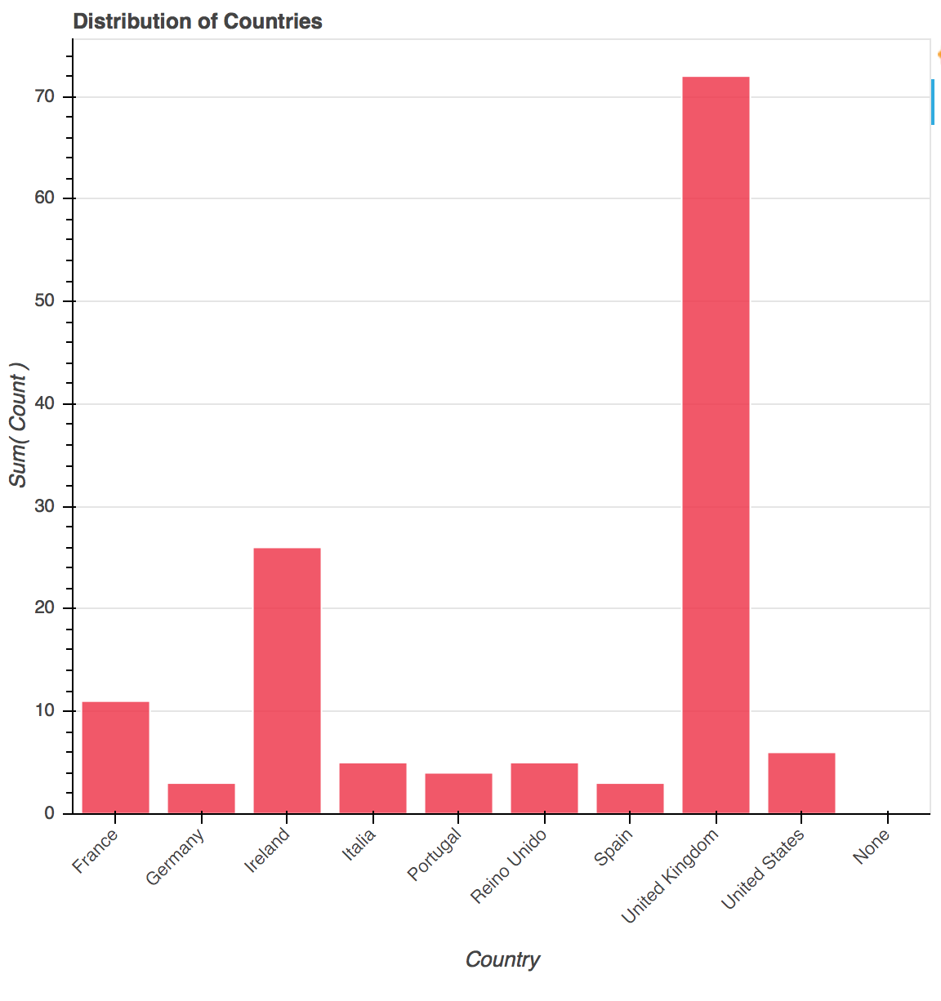
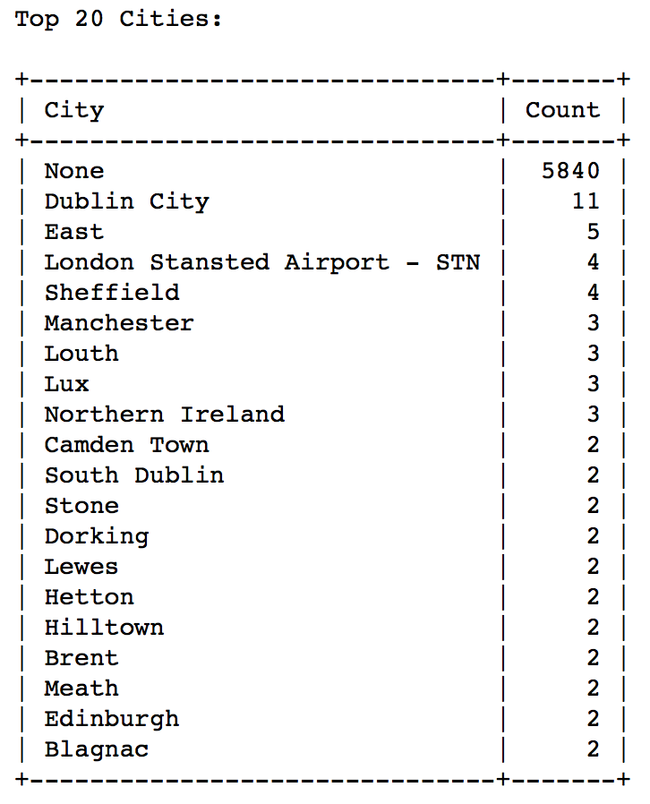
UK, Netherlands, France, Germany have the busiest airports in Europe

Slide 13
If 400,000 passengers have their flights cancelled, the total liability in compensation payouts is likely to be around £100 million, though not all who got impacted by this might claim
Hiring more employees might have cost them less.
Their reputation is going to be needed to be restored as the trust element has most likely been lost among the customers. They probably lost a lot of future customers.
They might need to allocate some of their advertising money to have alluring deals for the locations where they lost the most business to get customers back.

